Slide 1
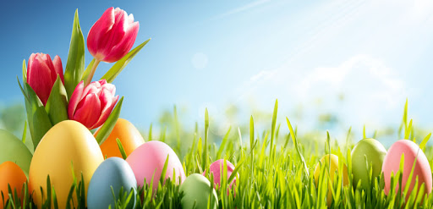
Easter in Poland

Slide 2
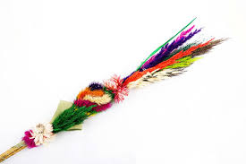
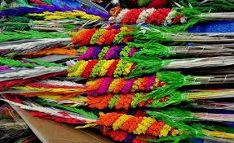
Palm Sunday falls 7 days before Easter. People come to the church for the mass with palm trees. This day is celebrated in memory of Jesus' entry into Jerusalem.

Slide 3
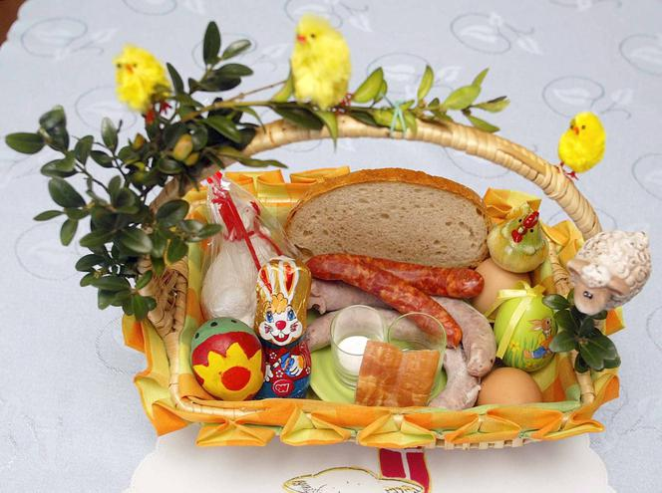
Święconka
Another Easter custom is to go to church with a basket with goods on Silent Saturday. The food that make up Święconki are usually eggs that symbolize a new life, a lamb symbolizing the Resurrection of Jesus Christ, table salt, pepper, bread, sausage, sausage, horseradish and festive cakes.

Slide 4
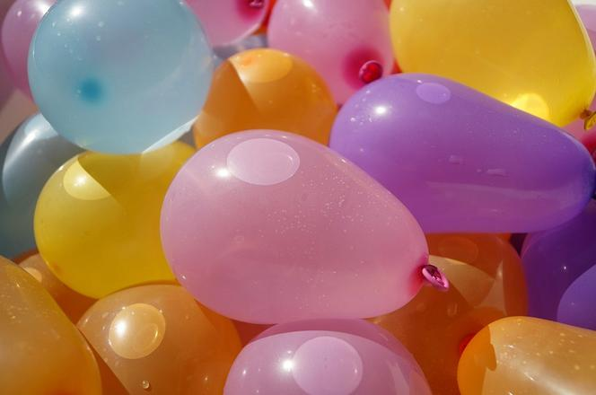
Śmigus-dyngus
Easter Monday, or „Lany” Monday, is about pouring water on each other.

Slide 5
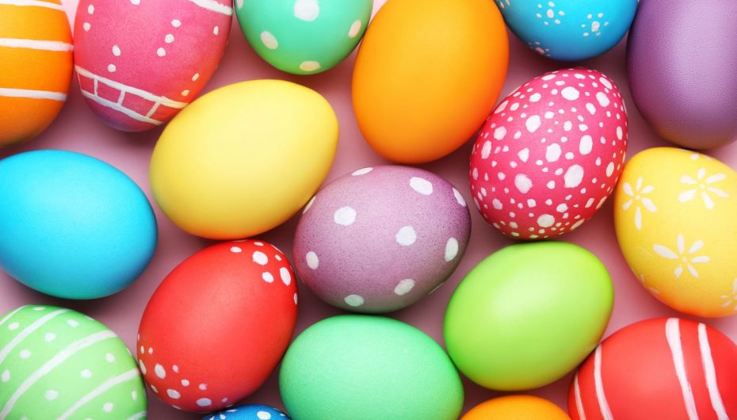
Painting Easter eggs
It is a custom in Poland to paint Easter eggs. They are differently colored.

Slide 6
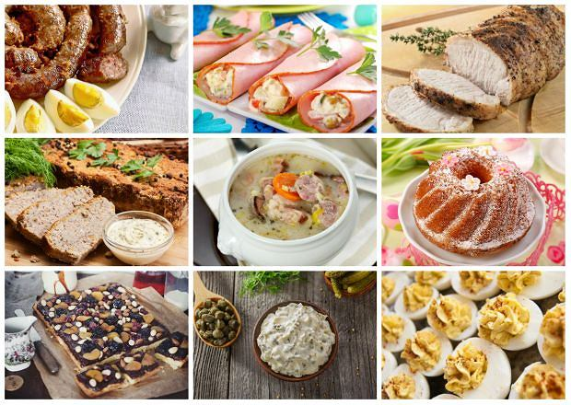
Easter breakfast
For Easter breakfast, sour rye soup, eggs, sausage, horseradish, bread, Easter cake and many more.

Slide 7
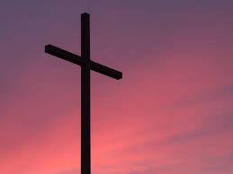
Interesting facts about Easter
Lent is to prepare for the Resurrection of the Lord. In Lent we fast and limit ourselves. But it's not about mortifying yourself, it's about cleansing and finding time to pray.
Maundy Thursday the unveiling of the cross on Good Friday is to highlight the mystery of the Sacrifice on the cross. He is discovered to begin adoration.

Slide 8
The Way of the Cross in an extreme version what are the extreme ways of the cross and what are they about? It is a passage in a group of a maximum of ten people around forty kilometers. You walk in silence with a small cross on your back.
The custom of painting eggs. The tradition of painting eggs for Easter according to tradition was initiated by Maria Magdalena. The Polish legend also says that the stones with which St. Stephen was stoned turned into red eggs. Eggs symbolize the beginning of life.

Slide 9
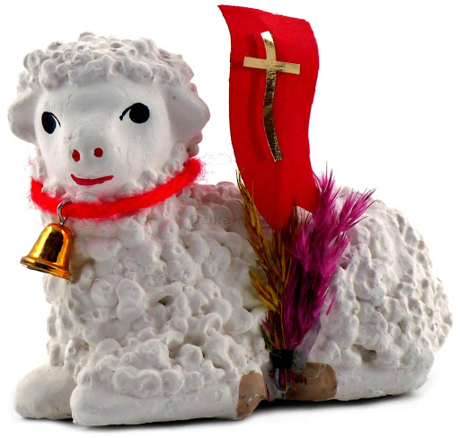
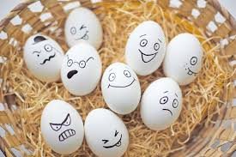
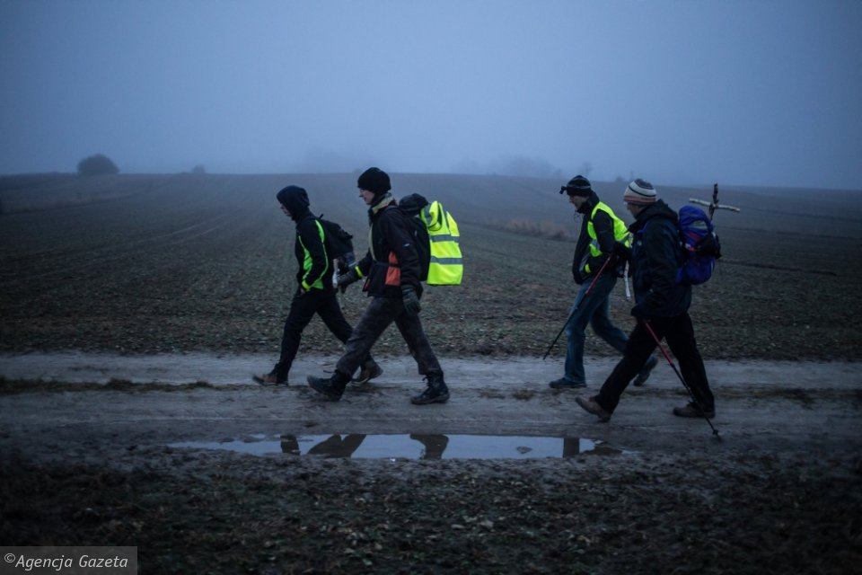
The lamb with the red banner with the cross is the symbol of Christ who is victorious.

Slide 10
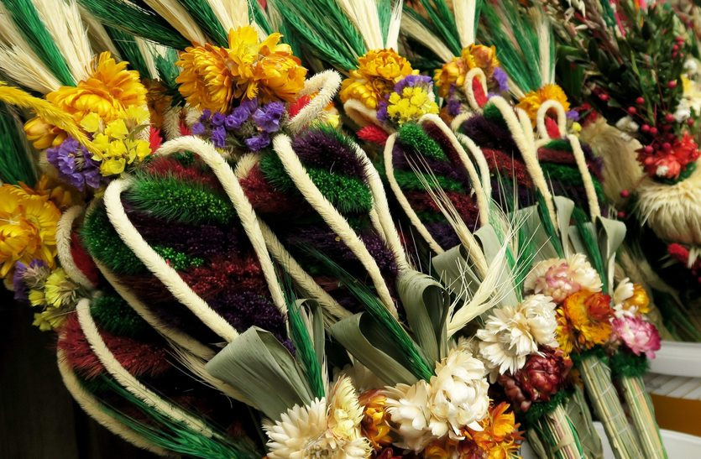
Quiz
How many days before Easter is Palm Sunday?
5
9
7

Slide 11
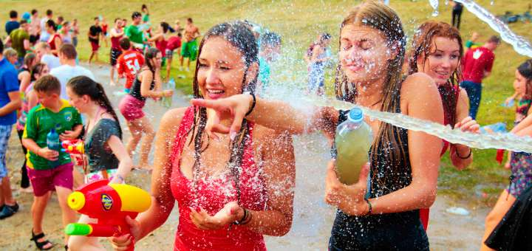
2. What do people pour each other with during smingus-dyngus?
Water
Milk
Juice

Slide 12
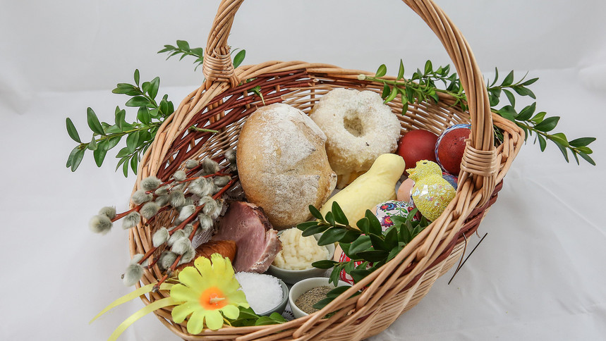
3. What do people put in the basket on Silent Saturday ?
sweets, chocolate etc.
eggs, sausage etc.
pencils, pens etc.

Slide 13
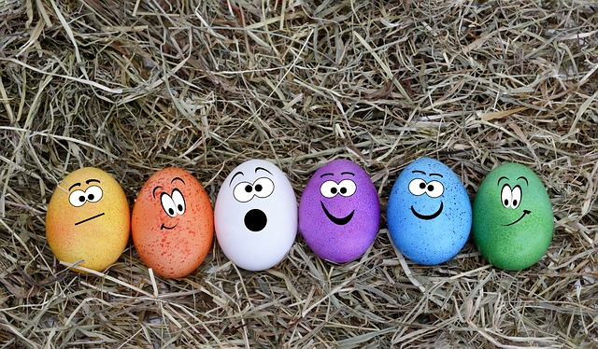
4. What colors are painted Easter eggs?
only black
different colors
they aren't painted

Slide 14
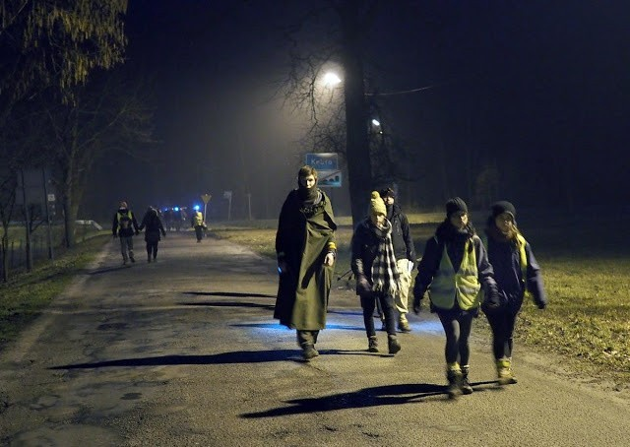
5. Which way do you go on Easter?
extreme way of the cross
fairy tale way
magic way

Slide 15
Correct answers
c) 7
a) water
b) eggs, sausage etc.
b) different colors
a) extreme way of the cross

Slide 16
Thank you for your attention
Paulina

